Slide 1
Beta 3
Shape of energy and momentum spectrum
Selection rules
F-tau tables

Slide 2






















Slide 3
















Slide 4




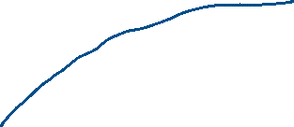




































Slide 5




What ever the correction is, the β- probability has to be reduced, so as a function of p, the Taylor expansion begins with 1/p.

Slide 6

















Which is the case in the low p limit we are looking at now.

Slide 7



























If neutrino mass is not zero, it’s creation has a minimum energy m_{ν}c² (instead of zero), and that reduces the maximum energy that the β can have.

Slide 8





























Slide 9

















Slide 10
















Slide 12






































Slide 13




















Slide 14














































Slide 15










































Slide 16







































Slide 17






































Slide 18





































Slide 19













S_{β} is the intrinsic spin angular momentum carried off by β−ν pair.

Slide 20






























Slide 21

































Slide 22



















































Slide 23


This plot is needed for one of the problems.

